Slide 1
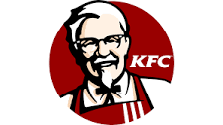
KFC(Kentucky Fried Chicken)
PRESENTED BY: Aliza Abdul salam,
Aqsa Razzaq
Areeba siraj
Ayesha altaf
Ayesha amjad
meishaim balkhi

Slide 2
INTRODUCTION
KFC (Kentucky Fried Chicken) is an American fast food restaurant chain headquartered in Louisville, Kentucky, that specializes in fried chicken.
KFC was founded by Colonel Harland Sanders (1890–1980), an entrepreneur who began selling fried chicken from his roadside restaurant in Corbin, Kentucky, during the Great Depression
Colonel Harland Sanders, created a finger lickin’ good recipe more than 75 years ago, a list of secret herbs and spices scratched out on the back of the door to his kitchen..
KFC, a subsidiary of Yum! Brands, Inc.
It’s leading in UK, Australia, South Africa, China, USA , Malaysia and many more.

Slide 3
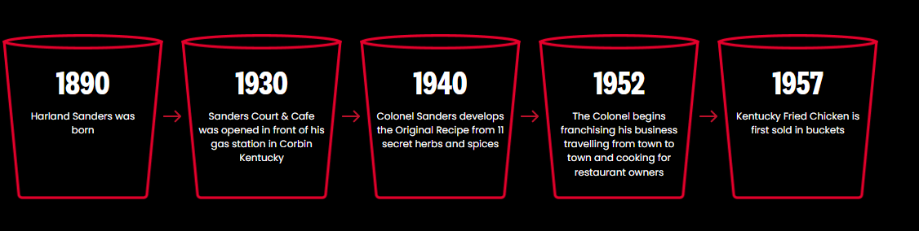
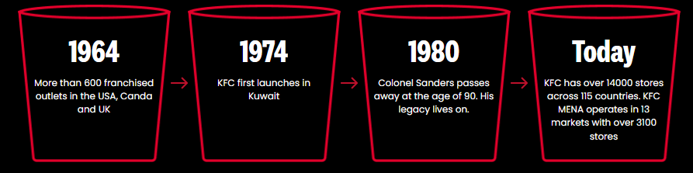
History Of KFC

Slide 4
Vision, Mission & Core Values
Vision:
"To provide food in a quick, pleasant setting that caters to cost-conscious, health-conscious people," KFC's products are also described in the vision statement's "great-tasting, high-quality meals" section.
Mission:
To serve finger-lickin’ good food to all our customers!
Core Values:
Team work
Privacy & safety
Pricing & productivity
Viability in long run

Slide 5

Objectives Of KFC
KFC has number of ambitious aims and objectives;
To increase its percentage share of the fast food market.
To improve profit margins year-on-year to fund the growth of the company.
To return profit on investments to owners and franchises.

Slide 6

Market Segmentation
Geographic Segmentation:. KFC deals internationally and has number of outlets in various countries.
Demographic Segmentation:
Age:6-65
Gender: Males & Females both
Family Size: 1-2,3-4,5+
Income: 10,000 n above.
Family Lifestyle: all

Slide 7
Market Segmentation
Psychographic Segmentation:
Social Class: Upper and Middle class
Lifestyle is not specific.
Personality is ambitious and authoritarian.
Behavioral Segmentation:
Well off, taste and quality seeking adults who are normally brand conscious, innovators & trend followers.
Health conscious, young adults who are interested in fast foods but prefer natural ingredients and low-fat substitutes.

Slide 8
Positioning & Target Market
Positioning:
KFC uses its attributes to Position its Product. To occupy a clear, distinctive and desirable place relative to competing products KFC, works on target consumer. In order to know the customer demands and improvements required, KFC takes feedback from the customers.). In this way KFC has positioned and differentiated itself from the competitor like Macdonald, King Burger, and Subway.
Target Market:
KFC targets the young generation, as here in this country the young generation is more towards eating out and is more energetic. It targets the early single segment that is the upper class.

Slide 9
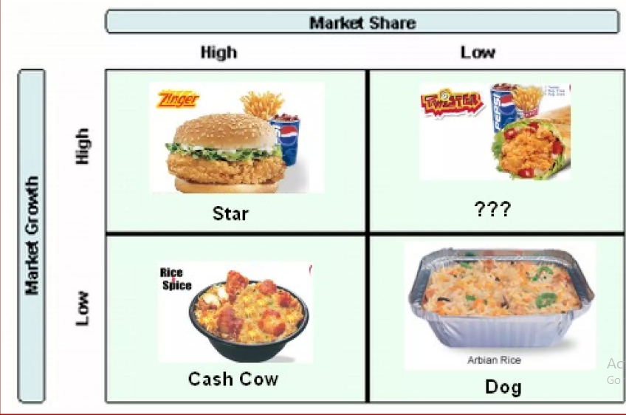
BCG MATRIX OF KFC

Slide 10
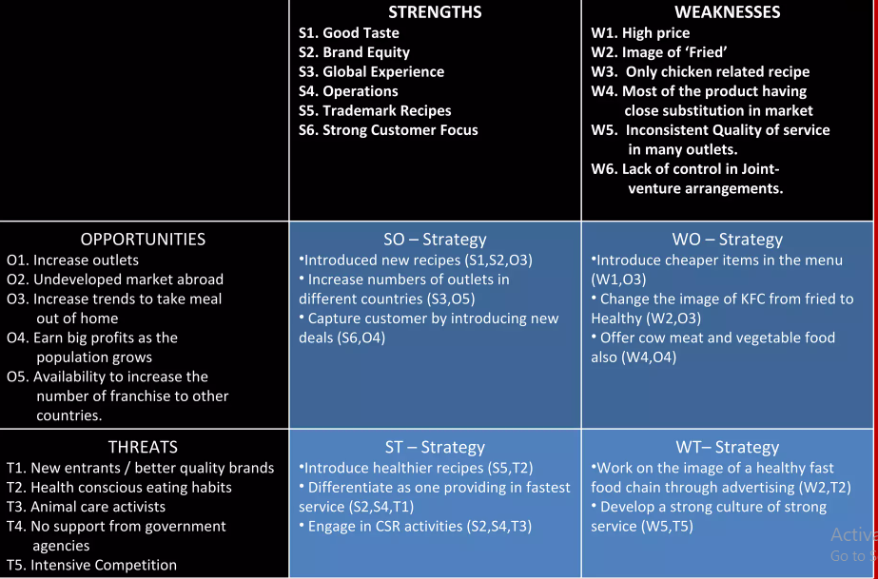
SWOT Analysis

Slide 11
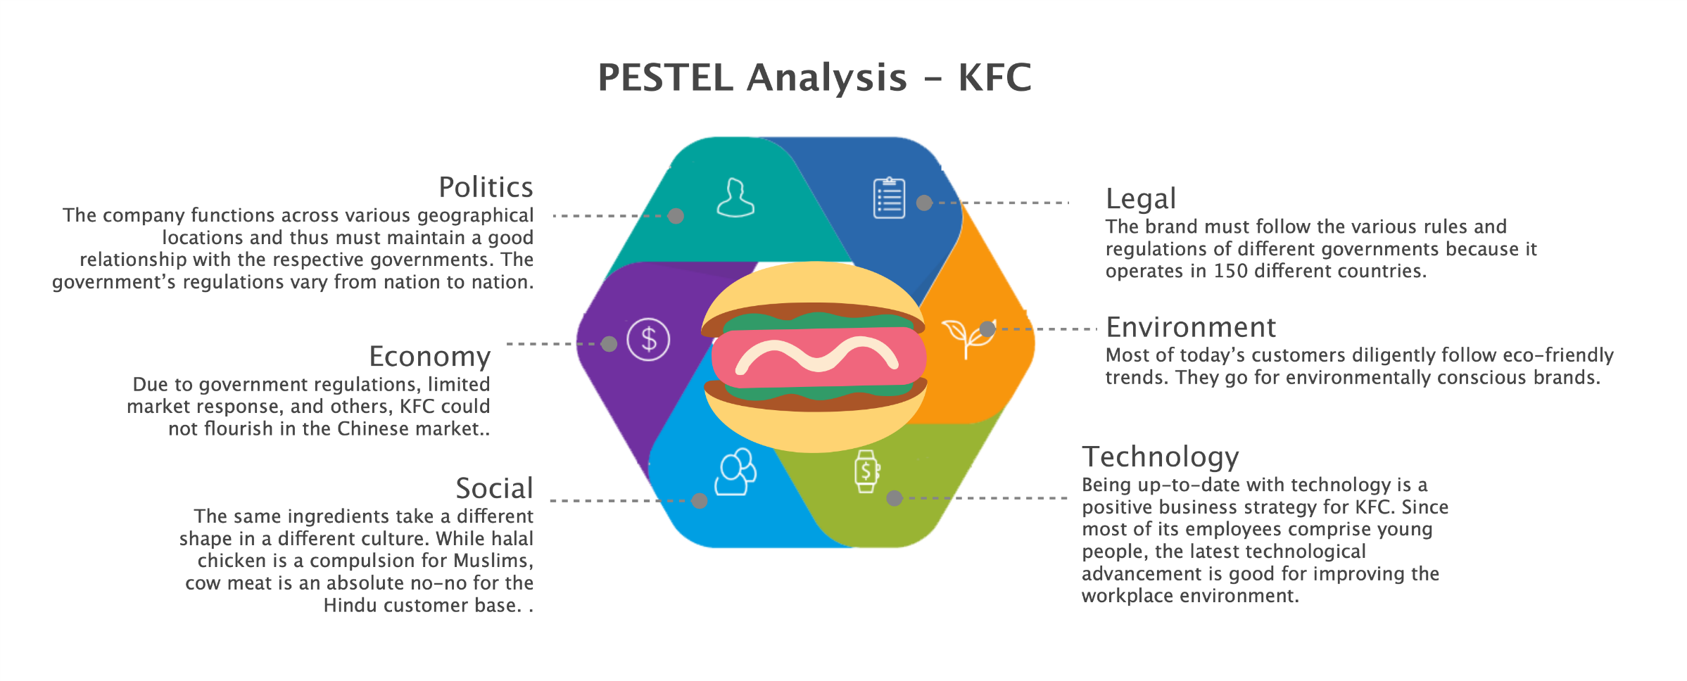
PESTAL Analysis

Slide 12
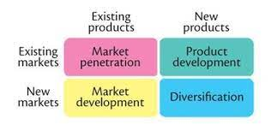
Product Market Expansion
Market Penetration:
Increase production capacity
increase its investment in marketing and advertising activities
Explore new channels of distribution for their products.
Market Development:
Invest in R&D
expand regionally
invests in activities of building brand awareness.

Slide 13
Product Market Expansion
Product Development:
introduce modifications and improvements in existing products.
engages in R&D activities to understand and identify new points of consumer demand.
engage in new product development by introducing different quality products.
Diversification:
explore growth by entering new businesses is through mergers.
KFC can opt for vertical diversification.

Slide 14
Current Market Situation Of KFC
Kentucky Fried Chicken (KFC) is one of the nation's most successful fast food organizations.
It has operations throughout the world, and has grown significantly both in the number of franchisees and company-owned stores.
KFC currently faces a wide range of challenges such as: frequent change of ownership, no of managements, competitors etc.
The company also has a strong product identification.
KFC's strengths is its dominant position in the marketplace.

Slide 15
Marketing Intermediaries & Distribution
The KFC marketing strategy incorporates two types of marketing channels:
Personal
Non personal
Distribution:
KFC always believes in keeping its outlet in superior areas as well as in malls and shopping complexes. These KFC outlets can also carry out delivery for online orders of KFC. As a result, KFC covers both – online and offline deliveries.

Slide 16
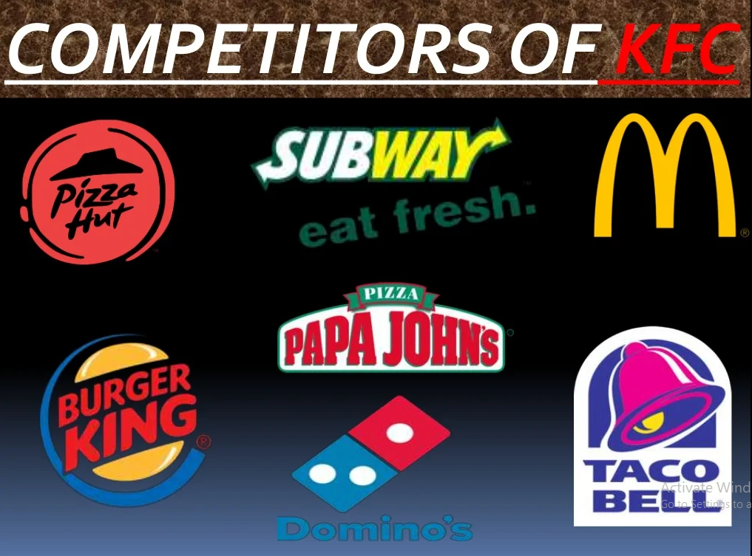
Competitors

Slide 17
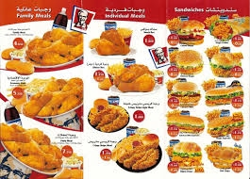
Products Of KFC
Chicken
Sandwiches
Meals
Sides
Bucket Meals
Drinks
Beverages
Milkshakes
Desserts
Ice Creams

Slide 18

Promotion
Newspapers
Television
Billboards
Webpages
Promotion
PR activities
Social Media

Slide 19
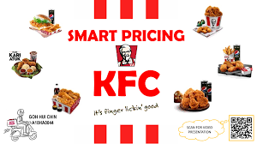
Price & place
Price:
Pricing strategy is the strategy used by firms to set the prices of their goods so that they can capture the attention of the market effectively and efficiently. KFC used the price skimming technique.
Place:
This strategy is concerned with tracking down the places the firm can find the potential buyers for its products.

Slide 20
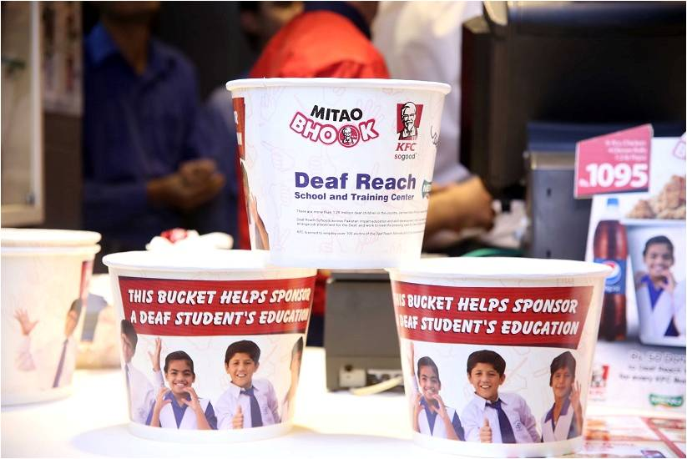
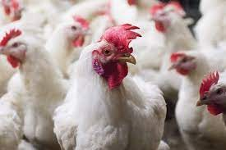
CSR Incentives
Following are the CSR incentives opt by KFC:
Mithao Bhook
Thankyou and Dhabbawalas
Feed a future
Chicken welfare

